Slide 1
Serverless Web Application
A serverless web application in AWS is a type of application architecture where developers can focus on writing and deploying code without the need to manage or provision servers. It leverages AWS services such as AWS Lambda, Amazon API Gateway, AWS Cognito, DynamoDB, AWS Amplify and other serverless components to handle the infrastructure and scaling automatically.

Slide 2





Serverless Web Application
AWS Amplify AWS Lambda DynamoDB API Gateway AWS Cognito
Technologies used

Slide 3

Serverless Web Application
HTML, CSSS, JS, Etc,.
AWS Amplify
Web Browser
Authenticate
AWS Cognito
Dynamic Api calls over HTTPS
AWS Gateway AWS Lambda DynamoDB

Slide 4
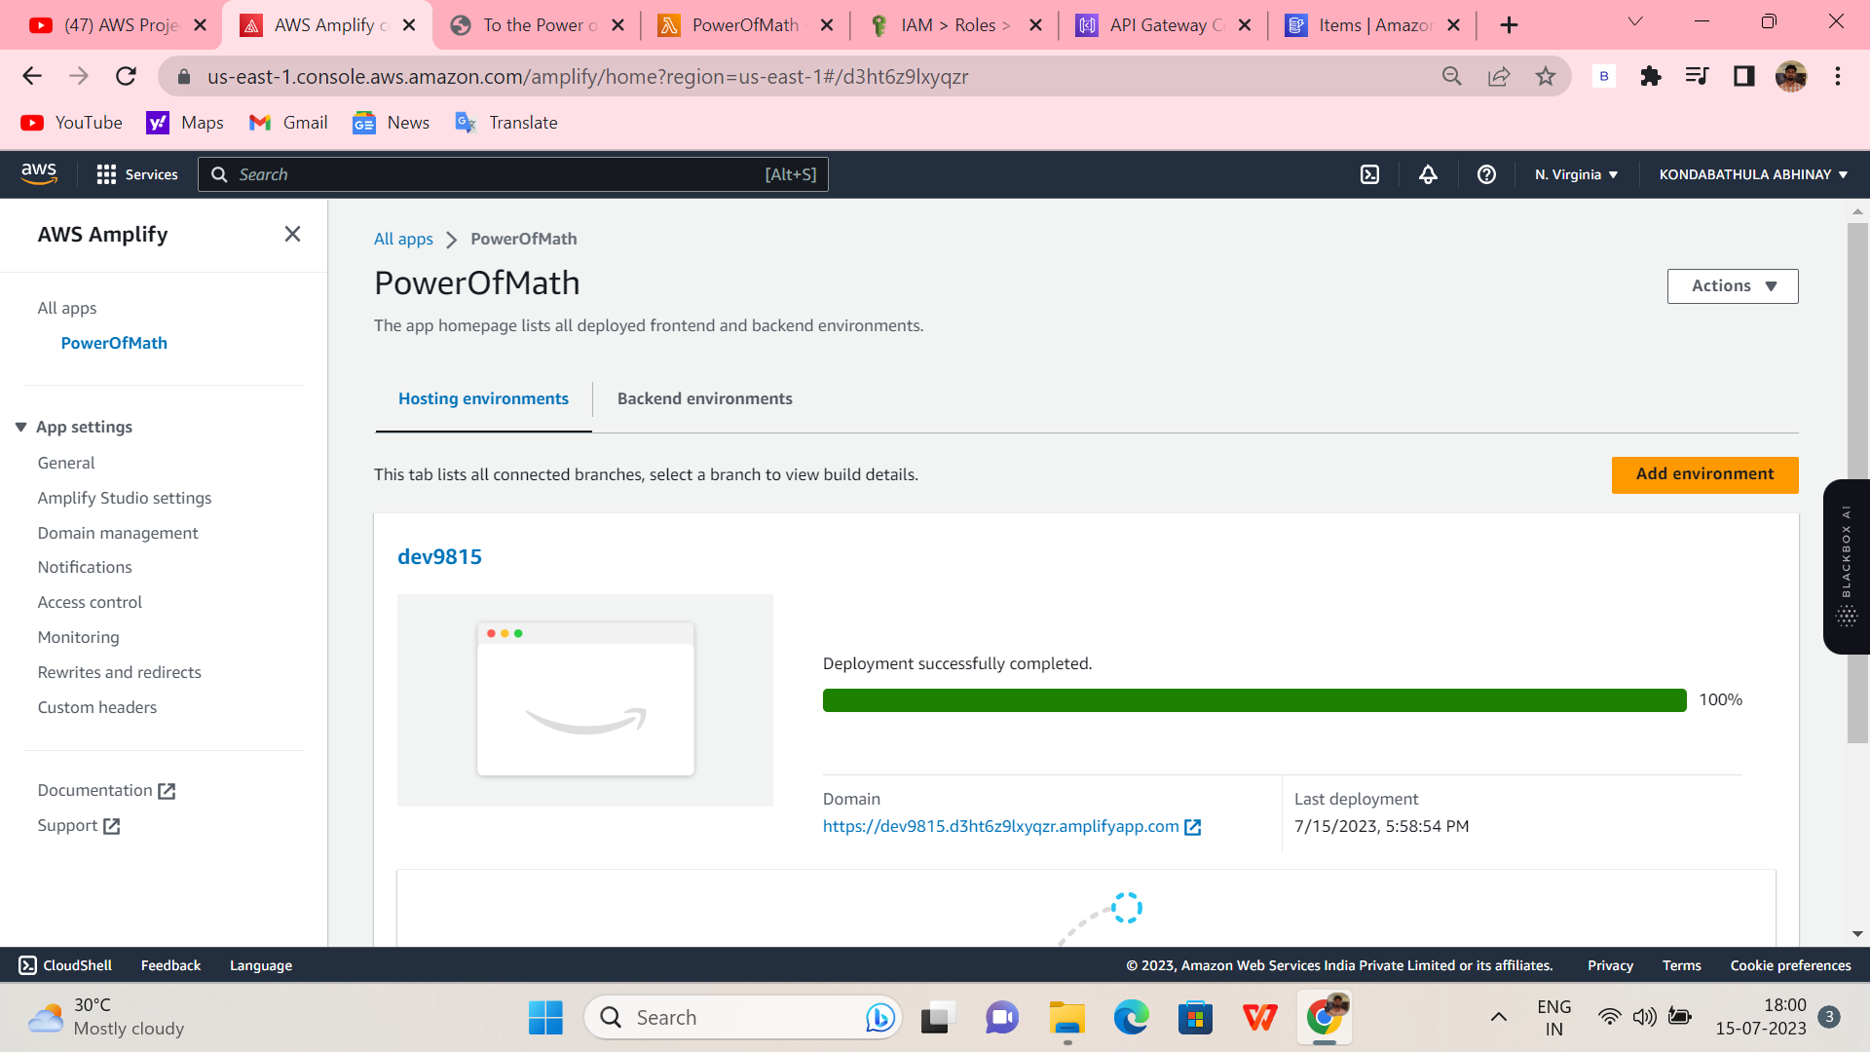
Aws Amplify setup!

Slide 5
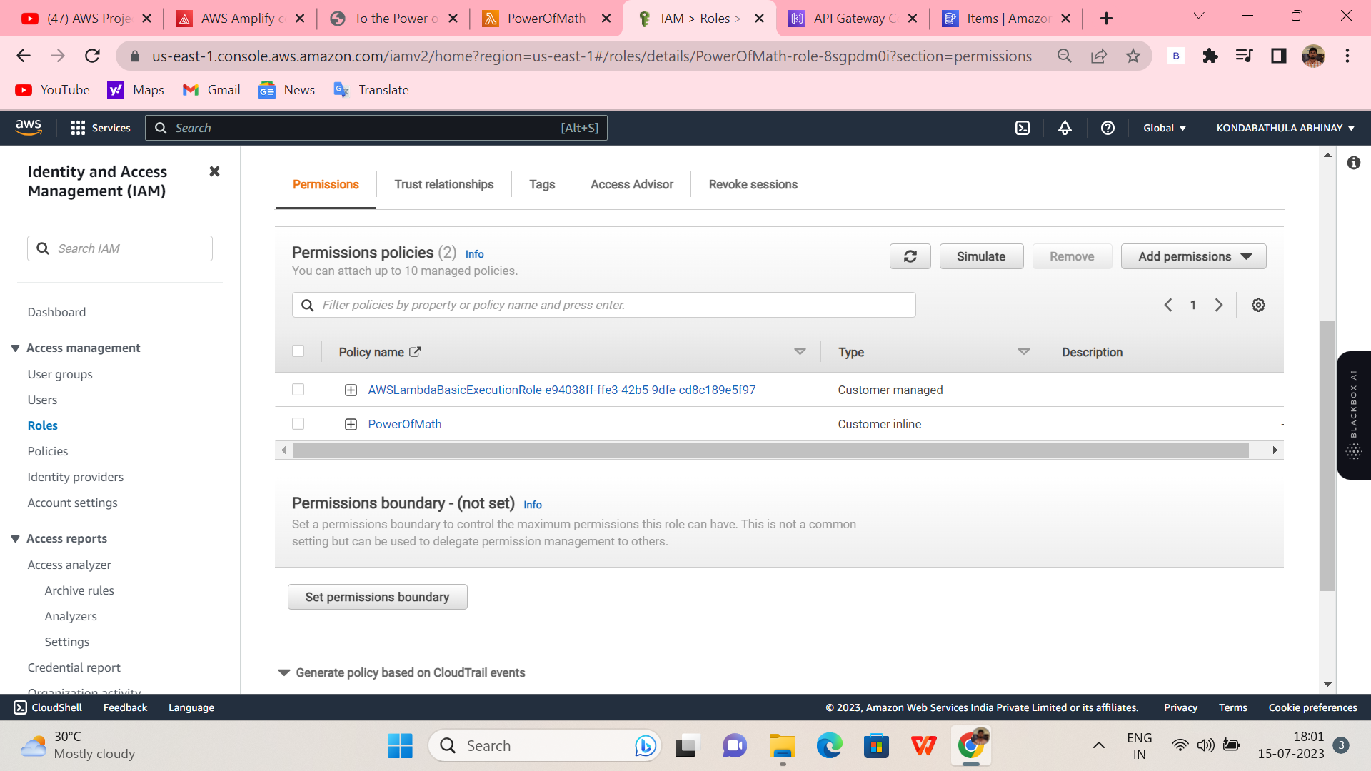
Cognito Setup!

Slide 6
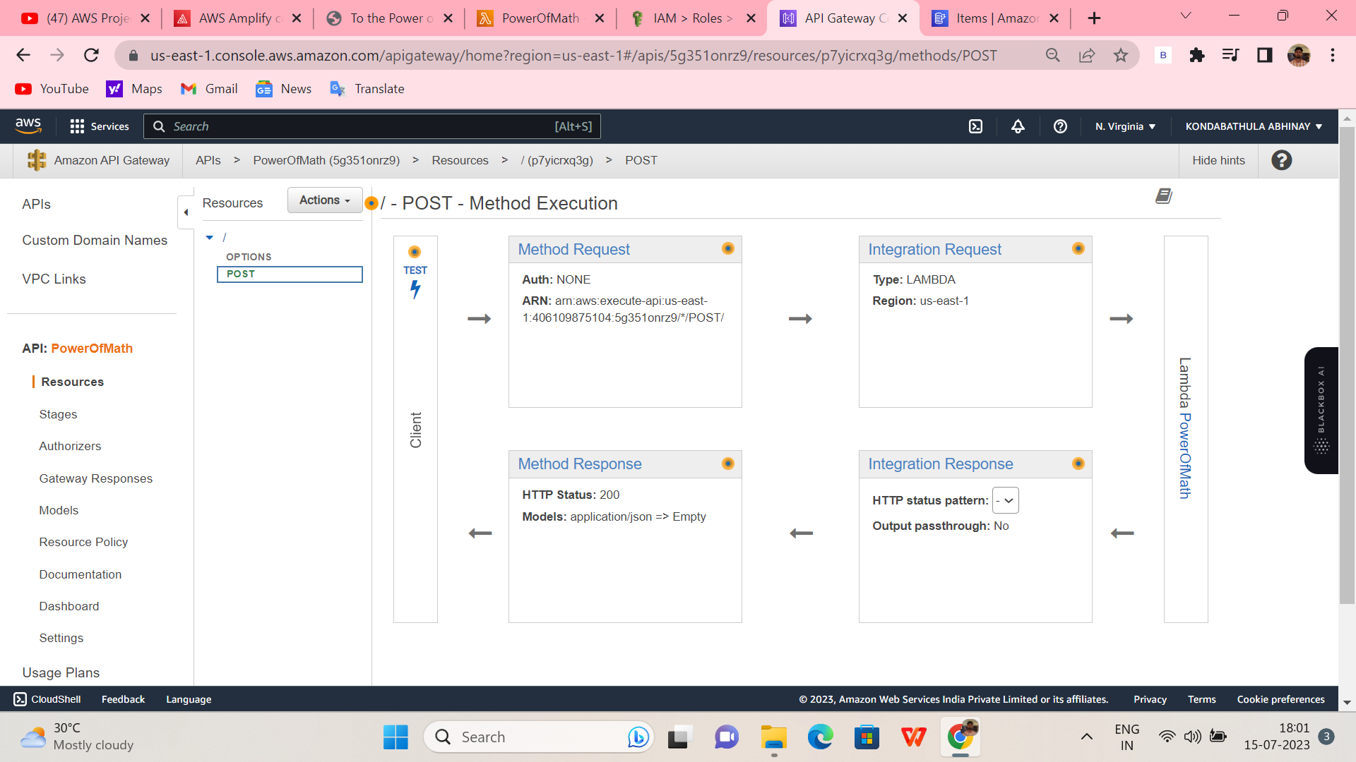
API Gateway Setup!

Slide 7
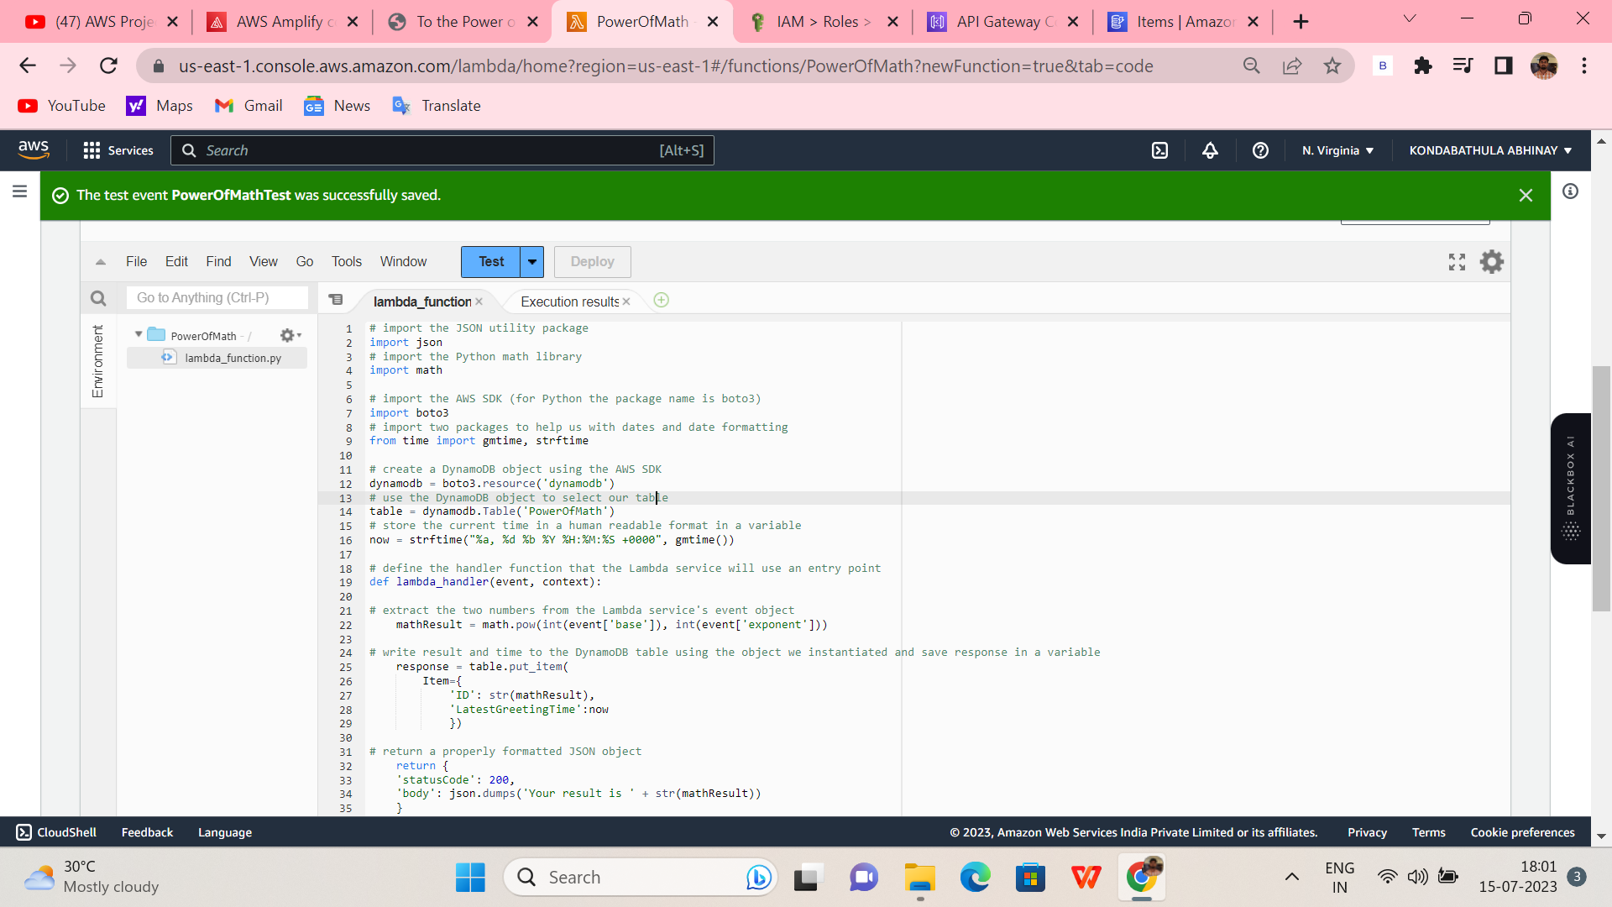
Lambda Setup!

Slide 8
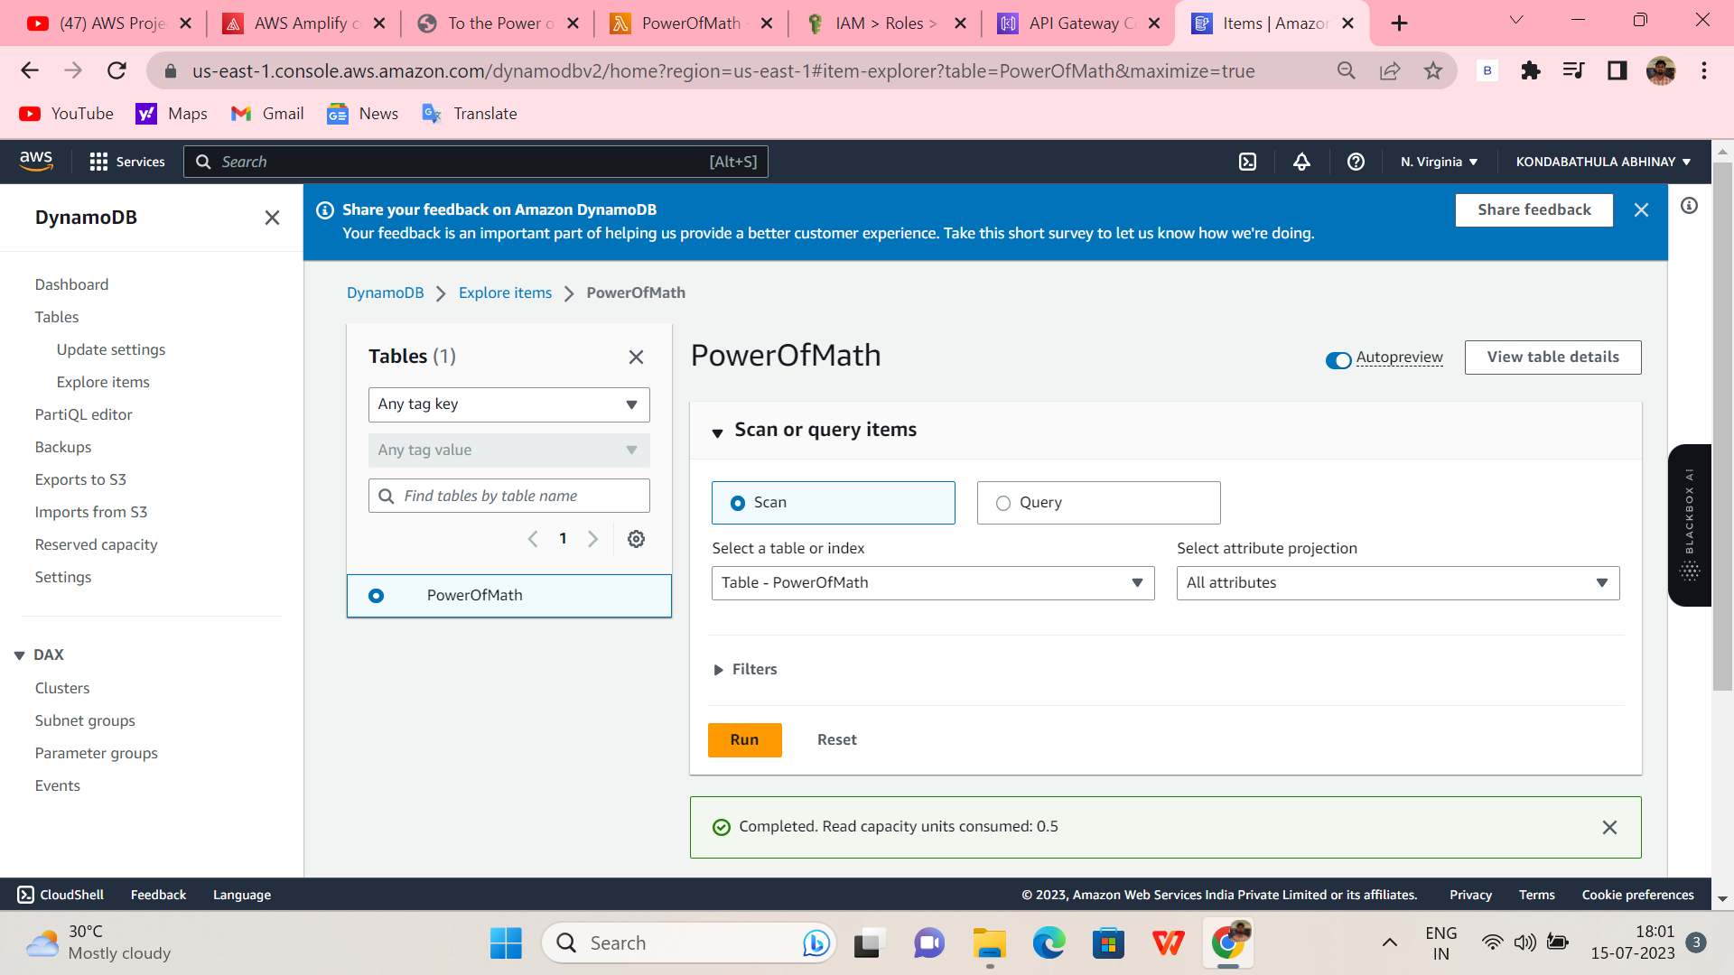
DynamoDB setup!

Slide 9
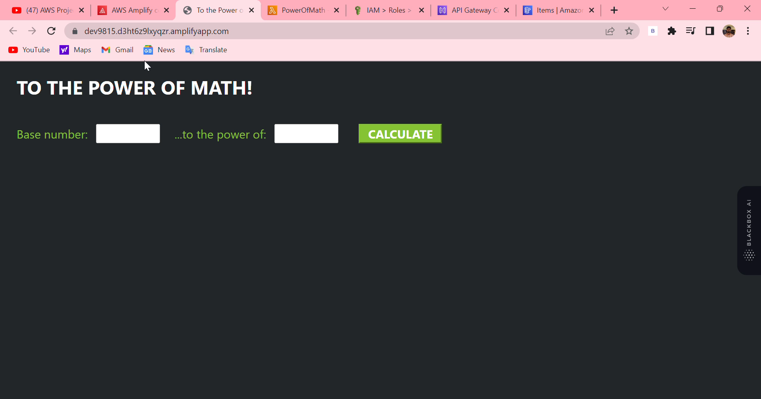
Demonstration Web App Power Of Math!

